Slide 1
Cyber Essentials: Becoming a Defender in Your Organization
Reanna Schultz 2023

Slide 2
About Me: Reanna Schultz
Kansas City, Missouri
University of Central Missouri
B.S Cybersecurity Secure Software Development - 2018
M.S Cybersecurity Information Assurance – 2020
Over 5 years of industry experience
Endpoint Security Engineering,
Network Security Engineering
SOC
Big Science Fiction reader!

Slide 3
Takeaways
Breakdown of cyber
Anatomy of data breaches
Understanding your role as a defender
When the human firewall fails
Resources and materials

Slide 4
Vulnerability Management
Business Security Needs
Pentesters
DFIR
Application Security
SOC
Threat Intel
Network Security
Cloud Security
Endpoint Security

Slide 5
Why Being a Defender is Important
Security mechanics exist, but they can fail or not 100% trusted
Firewall – Network security
Antivirus – Endpoint security
Email filters – Email security
Threats are forever evolving
Understanding and knowing is essential
Key to becoming a successful defender in your business

Slide 6
Cyber Threats – What Are They?
When a malicious actor or intent occurs to steal information​
Information can be considered personal or business​​
Create data breaches​
Data breaches can be a result of different types of cyber threats​​
Phishing - Emails, phone calls, text messages, etc.​​
Interacting with malicious websites ​​
Downloading malware that might appear as a legitimate application​​
MANY different possibilities

Slide 7
Phishing
One of the most common and popular forms of cyber threats
Well known but if you receive a phish
Bypassed security mechanics in a business
You are THE last stop to potentially introducing a risk
Goal is to use social engineering techniques to introduce threats
Backdoor communication
Ransomware
Other unwanted activity

Slide 8
Hershey’s Chocolate Breach
September 3rd, Hershey’s employee received a phishing email
Employee clicked on the email
Threat actor reported to live in the environment for 2 days
Hershey stated over 2k+ individuals were impacted by the breach
Personal information and financial accounts were compromised
Altering company recipes
Containment and remediation
All user accounts had new logins
Hershey spent over $1 million in third-party cyber services and restoration

Slide 9
Defending Against Phishing
To: @gmail.com
From: dwsoq@sales.force.com
Unexpected user
Generic greeting
Email context does not make sense
Suspicious link when hovering
Generic closing

Slide 10
Internet Usage
Using the internet is part of our day-to-day job function
Cyber threats can be hidden in plain site
“Sponsor” pages
Advertisements
Unsecure websites
Interacting with potentially malicious content
Directed to a potentially malicious website
Download of malware
Stealing saved passwords in the browser

Slide 11
Meta Ads
Threat actors are utilizing social media ads to “click bait” victims
Advertisements will appear to be luring or topics the general audience will be interested in
Meta released discovery of this in early November.
Once a person clicks on the advertisement
The advertisement will redirect them to a post
During redirects, malware will be downloaded
The malware will then collect saved passwords and social media login information
Cyber researchers have discovered 15k+ downloads within a 24-hour span

Slide 12
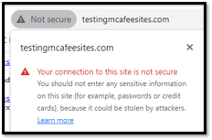
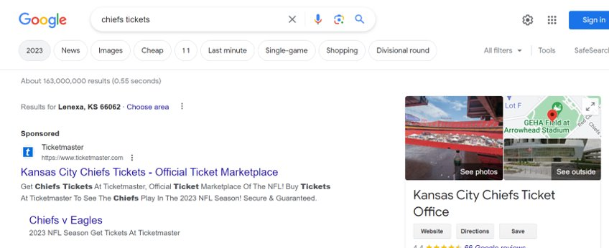
Defending Against Internet Threats
Avoid websites that do not use https://
Avoid clicking on ads or sponsor pages
Instead, go directly to the website
Avoid
Preferred

Slide 13
Malicious Programs
Malicious programs are programs that can bring harm to your computer
Allowing threat actors access to the system or other information
Establishing persistence
Introducing harmful risks
From many different sources
Emails or other Social Engineering techniques
Through advertisements
Malicious websites
Malicious programs can appear to be
Legitimate programs
Unexpected programs

Slide 14
Fake Job Recruiters
Identified a trend during October of this year
Threat actor would create fake LinkedIn profiles
Profiles would hold job titles like “manager”
Target LinkedIn users who were in Social Media management
Threat actor would message the profile and lure them into interacting with a malicious artifact through LinkedIn message
Once the file was open
Malicious program was introduced to the victim’s computer
Malware would attempt to uninstall security mechanics
Carve saved credentials on the browser

Slide 15
Becoming a Defender
Avoid doing personal activities on your corporate devices
Mail
Personal internet browsing
Using your corporate email for personal activities
Do not store passwords or important logins through your browser
A lot of free password safes
THINK before clicking
Does this seem expected?
Does this appear to be legit?
What are the risks?

Slide 16
Resources and Materials
News:
https://bleepingcomputer.com
https://thehackernews.com
https://secureworld.io
Cyber hands-on experience:
https://tryhackme.com

Slide 17
Thank you! Questions?

